Slide 1
Thực hành Lab2

Slide 2
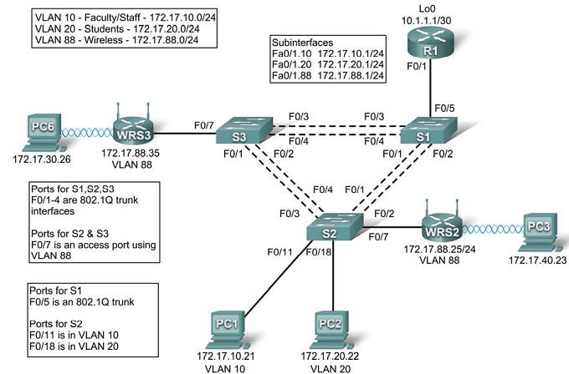
Topology Diagram

Slide 3
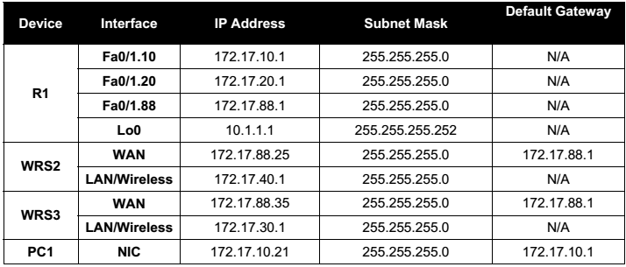
Addressing Table

Slide 4
File pdf: Lab2

